Slide 1
AWS Introduction and Amazon Data Analytics Pipeline
Kapil Dwivedi
Sr Technical Account Manager

Slide 2
Agenda
AWS 101
Data Analytics Solution
Collection
Storage
Processing
Analysis
Visualization

Slide 3
AWS 101
Amazon Web Services (AWS) is the world’s most comprehensive and broadly adopted cloud platform, offering over 200 fully featured services from data centers globally. Millions of customers—including the fastest-growing startups, largest enterprises, and leading government agencies—are using AWS to lower costs, become more agile, and innovate faster.
Key facts
One in three sites you visit on the internet uses AWS services.
In 2019, Amazon Web Services raked in more than $35 billion in revenue. If AWS were its own company, that would be enough to rank 359th on fortune magazine’s Global 500 list
Notes:
Agility
Elasticity
Cost savings
Deploy globally in minutes

Slide 4
AWS 101 - Global Infrastructure
The Most Secure, Extensive, and Reliable Global Cloud Infrastructure, for all your applications
The AWS Cloud spans 81 Availability Zones within 25 geographic regions around the world.
Additionally, there are over 200 edge locations scattered around the world as part of AWS’s content delivery network (CDN).
Notes:
The AWS Cloud spans 81 Availability Zones within 25 geographic regions around the world, with announced plans for 27 more Availability Zones and 9 more AWS Regions in Australia, Canada, India, Indonesia, Israel, New Zealand, Spain, Switzerland, and United Arab Emirates (UAE)

Slide 5
AWS 101
How can we access UI, API, and CLI
Create a new AWS account
Secure the root user
Create an IAM user to use in the account
Set up the AWS CLI
Setup Billing alarm, budget and cost explorer

Slide 6
Amazon Data Analytics Pipeline
Collection
Storage
Processing
Analysis
Visualization

Slide 7
Amazon Data Analytics Pipeline
Collection

Slide 8
Amazon Data Analytics Pipeline
Collection - Moving data into AWS
Real Time - Immediate actions
Kinesis Data Streams (KDS)
Simple Queue Service (SQS)
Near-real time - Reactive actions
Kinesis Data Firehose (KDF) •
Database Migration Service (DMS)
Batch - Historical Analysis
Snowball

Slide 9
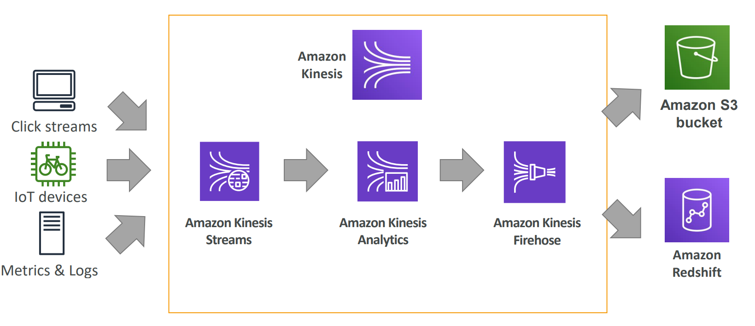
Kinesis
Notes:
Kinesis Data Streams (KDS) – collect and process large stream of data real time, low latency streaming ingest at scale
Kinesis Data Analytics – Allows us process and analyze streaming data real time with SQL
Kinesis firehouse - Used to load streaming data in services like Redshift, ES, S3

Slide 10
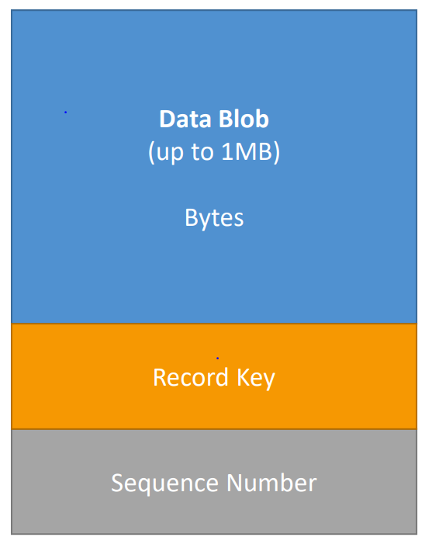
Kinesis over view
Kinesis is a managed alternative to Apache Kafka
Great for application logs, metrics, IoT, clickstreams
Data is automatically replicated synchronously to 3 AZ
Data retention is 24 hours by default, can go up to 7 days
Ability to reprocess / replay data
Multiple applications can consume the same stream
Once data is inserted in Kinesis, it can’t be deleted (immutability)
Kinesis Streams Records
Data Blob – 1MB
Record Key - Same key = Same shard
Sequence number - Unique identifier for each records put in shards
Kinesis Data Streams Limits
1MB/s or 1000 messages/s at write PER SHARD
2MB/s at read PER SHARD across all consumers
Producers - kinesis SDK, Kinesis Producer Library (KPL) , Kinesis Agent, 3 rd party libraries: Spark, Kafka Connect
Kinesis Consumers - Kinesis Firehose, AWS Lambda
Notes:
Kinesis Data Streams (KDS) – collect and process large stream of data real time
Kinesis Data Analytics – Allows us process and analyze streaming data real time with SQL
Kinesis firehouse - Used to load streaming data in services like Redshift, ES, S3

Slide 11
Kinesis Firehose
Producers send data to Firehose, There are no Shards, completely automated (scalability is elastic).
Firehose data is sent to another AWS service for storing, data can be optionally processed/transformed using AWS Lambda
Near real-time delivery (~60 seconds latency)
Kinesis Data Firehose destinations
RedShift (via an intermediate S3 bucket)
Elasticsearch,
Splunk
Datadog
MongoDB
HTTP Endpoint
Amazon S3

Slide 12
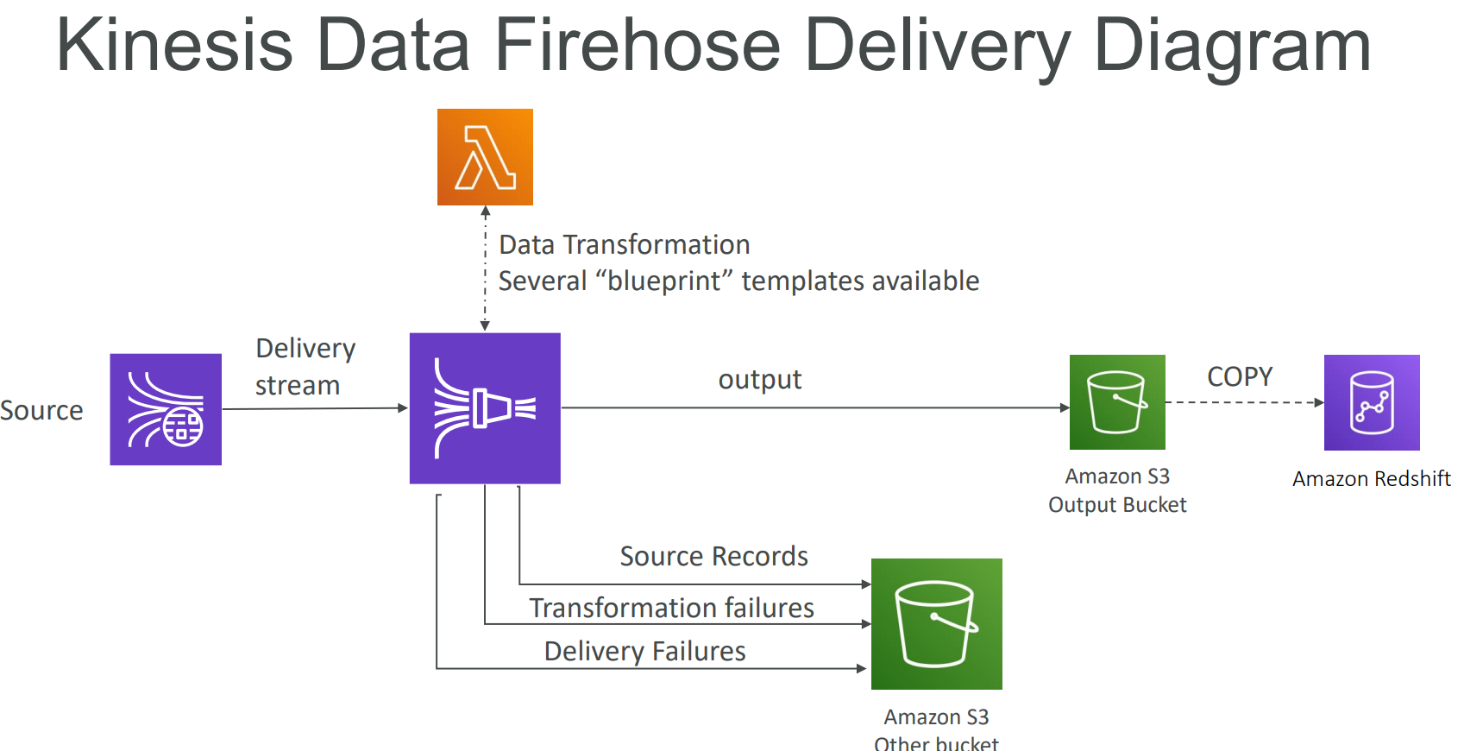
Kinesis Firehose

Slide 13
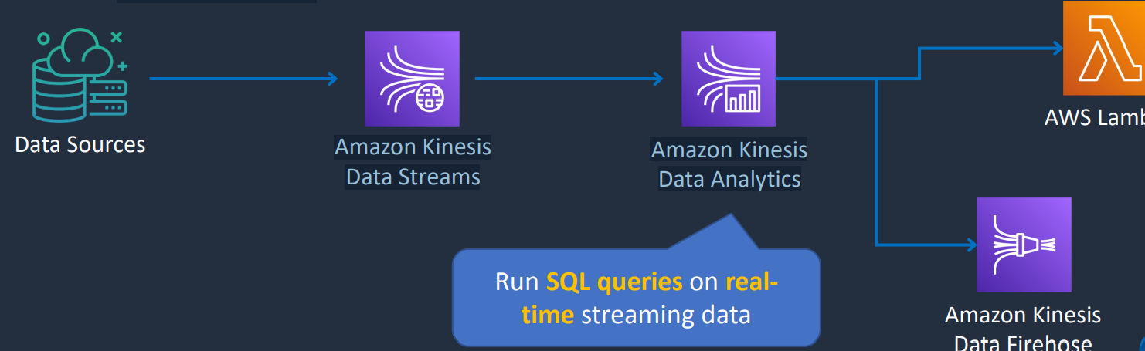
Kinesis Analytics
Provides real-time SQL processing for streaming data
Provides analytics for data coming in from Kinesis Data Streams and Kinesis Data Firehose
Destinations can be Kinesis Data Streams, Kinesis Data Firehose, or AWS Lambda Amazon Kinesis Data Streams Amazon Kinesis Data Analytics

Slide 14
Amazon Data Analytics Pipeline
Collection - SQS

Slide 15
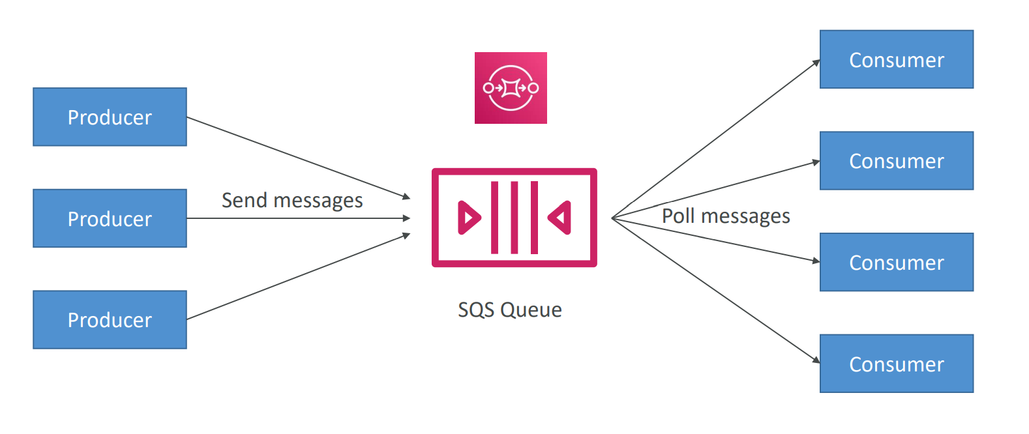
SQS – Decouple applications

Slide 16
AWS SQS – Standard Queue and FIFO
Standard Queue
Unlimited Throughput - Unlimited TPS
Best-Effort Ordering
At-Least-Once Delivery
FIFO Queue
High Throughput: 300 message/sec
First-ln-First-out Delivery
Exactly-Once Processing
FIFO queues require the Message Group ID and Message Deduplication ID parameters to be added to messages.
Dead Letter Queue - Dead-letter queue is designed for handling message failure.
Amazon SQS delay queues
SQS Long Polling vs Short Polling - Long polling can lower costs, can be enabled at queue level of API level WaitTimeSeconds.
Max message size is 256KB (or use Extended Client)
Data retention from 1 minute to 14 days

Slide 17
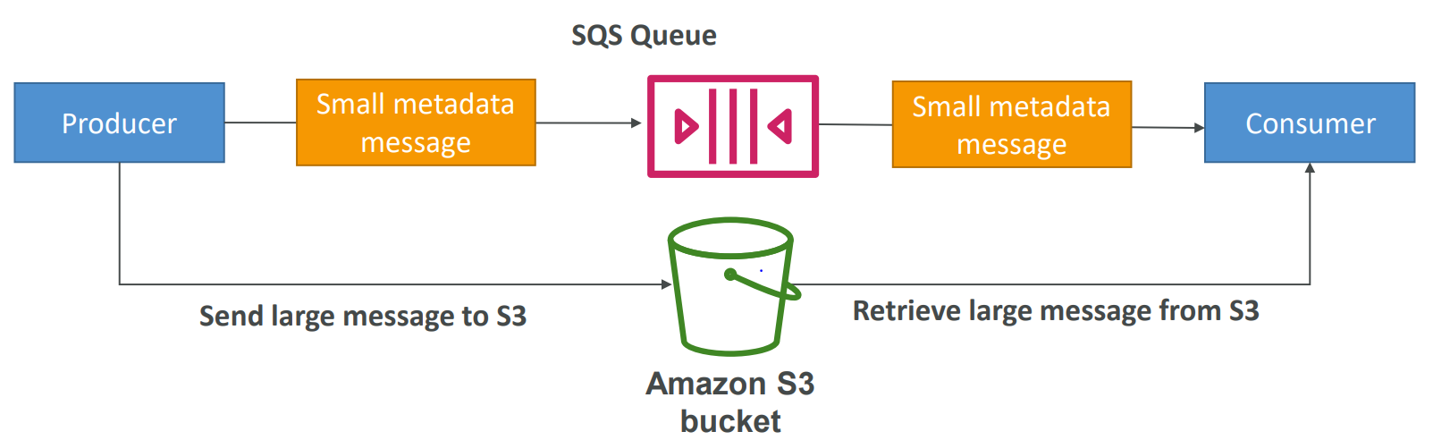
AWS SQS – SQS Extended Client
Message size limit is 256KB, how to send large messages?
Using the SQS Extended Client (Java Library)

Slide 18
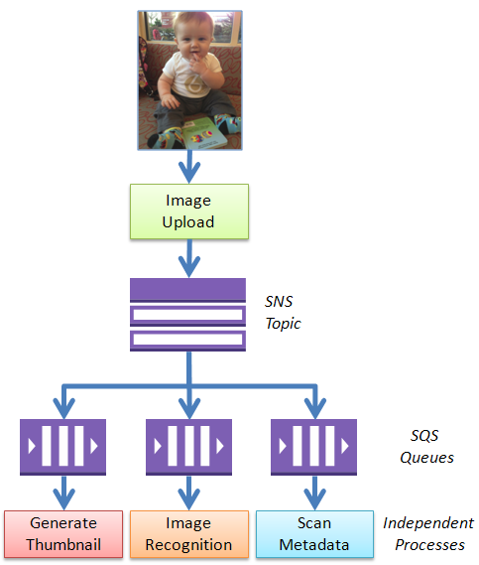
SQS Queues and SNS Notifications – Now Best Friends
One common design pattern is called “fanout.” In this pattern, a message published to an SNS topic is distributed to a number of SQS queues in parallel. By using this pattern, you can build applications that take advantage parallel, asynchronous processing. For example, you could publish a message to a topic every time a new image is uploaded. Independent processes, each reading from a separate SQS queue, could generate thumbnails, perform image recognition, and store metadata about the image:

Slide 19
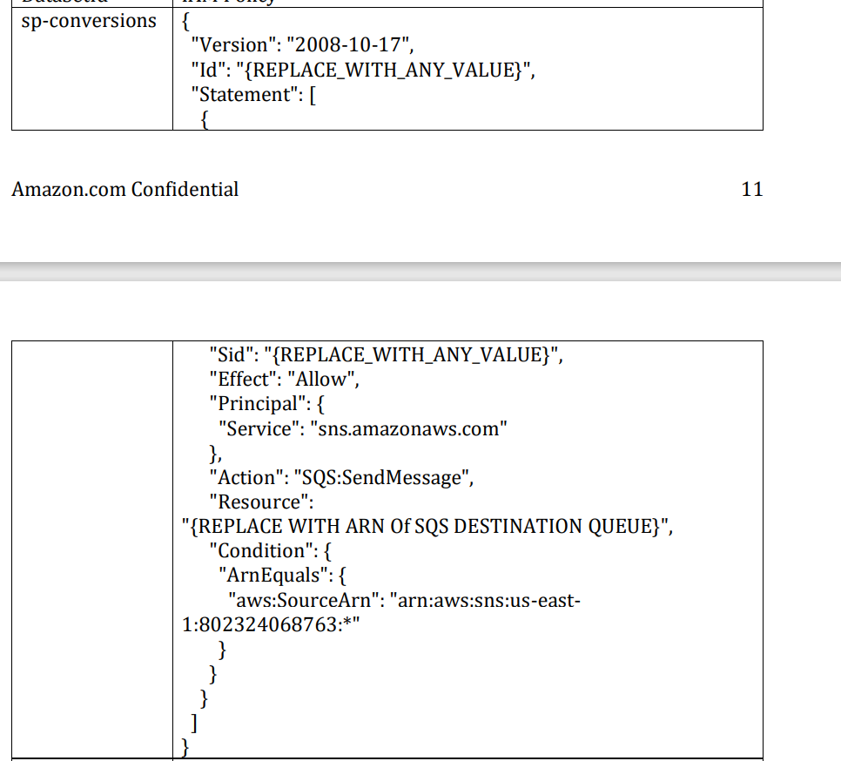
Anatomy of JSON policy
Resource-based policies are JSON policy documents that you attach to a resource such as an Amazon S3 bucket, or SQS.

Slide 20
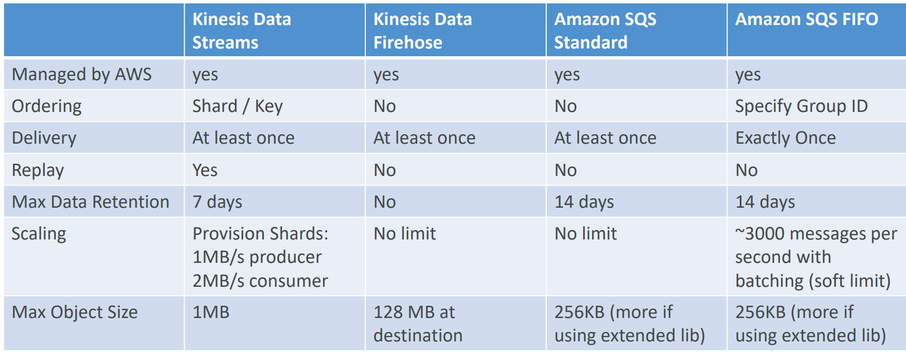
Streams vs Firehose and Amazon SQS

Slide 21
Amazon Data Analytics Pipeline
Storage

Slide 22

Simple Storage Service
Amazon S3 provides a simple web service interface that can be used to store and retrieve any amount of data, at any time, from anywhere on the web. The service gives any developer access to the same highly scalable, reliable, secure, fast, inexpensive infrastructure that Amazon uses to run its own global network of websites. The service aims to maximize benefits of scale and pass those benefits on to developers.
Amazon Simple Storage Service Amazon S3

Slide 23
S3 Storage Classes
S3 Standard –
General purpose storage for active, frequently accessed data with millisecond access
S3 Intelligent-Tiering –
Only cloud storage class with automatic cost savings by moving objects between two tiers.
S3 Standard-Infrequent Access (S3 Standard-IA) –
Long-term storage, backups, and disaster recovery
S3 One Zone-Infrequent Access (S3 One Zone-IA) –
Ideal for secondary backups and workloads with easily re-creatable data
S3 Glacier –
Archive or backup data with secure, durable, and low-cost storage
S3 Glacier Deep Archive –
Lowest-cost cloud storage for long-term archives at about

Slide 24
Simple Storage Service
Life cycle policies
S3 Versioning
S3 Replication
S3 Encryption
S3 Event Notifications
Store anything
Secure object storage
Natively online, HTTP access
Unlimited scalability
99.999999999% durability

Slide 25
Dynamo DB
Fully managed NoSQL database service
It is a non-relational, key-value type of database good for when data is not well structured or unpredictable
Fully serverless service, Highly available, fault tolerant, service
Horizontal, Push button scaling
DynamoDB Time to Live (TTL)
DynamoDB Streams - A Lambda function can be triggered
DynamoDB Accelerator (DAX) -Fully managed in-memory cache for DynamoDB that increases performance (microsecond latency)

Slide 26
Amazon Data Analytics Pipeline
PROCESSING - AWS Lambda, Amazon EMR, Amazon ML, Amazon SageMaker

Slide 27
AWS Lambda - Serverless data processing
A way to run code snippets “in the cloud”
• Serverless
• Continuous scaling
Main uses of Lambda
Real-time file processing
Real-time stream processing
ETL
Cron replacement
Process AWS events
Supported language –
Node.js • Python • Java • C# • Go • PowerShell • Ruby
Lambda Triggers –
Synchronous Invocation method with Request Response - API Gateway, Load Balancer, AWS Step Functions
CloudFront (Lambda@Edge), Amazon Kinesis Data Firehose, Amazon Cognito, Amazon Alexa
Asynchronous Invocation method with Event – S3,SNS, CF, Cloud Watch, Events, IOT, Developer Tools
Event Source Mapping method with Poll Based - Kinesis, DynamoDB, Simple Queue Service

Slide 28
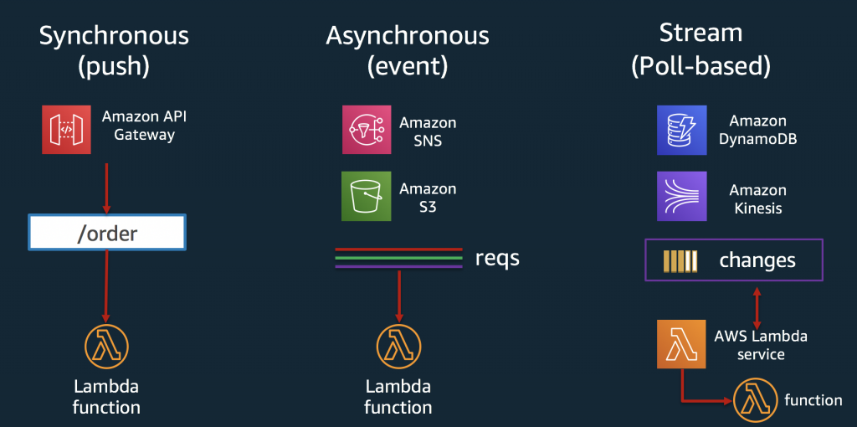
AWS Lambda - Serverless data processing

Slide 29
AWS Lambda
Cost -
Pay for what you use” Generous free tier (1M requests / month, 400K GB -seconds compute time)
$0.20 / million requests
$.00001667 per GB/second
Antipatterns -
Stateful applications
Long running Apps – 15 min timeout limit

Slide 30
Amazon Data Analytics Pipeline
Analysis - ES, Athena, Redshift

Slide 31
What is Athena - Serverless
Interactive query service for S3 (SQL)
No need to load data, it stays in S3
Unstructured, semi-structured, or structured
Supports many data formats
• CSV (human readable)
• JSON (human readable)
• ORC (columnar, split table)
• Parquet (columnar, split table)
• Avro (split table)

Slide 32
Athena - Use cases
Querying staging data before loading to Redshift
Integration with Quick Sight
Integration via ODBC / JDBC with other visualization tools

Slide 33
Data warehouse
A data warehouse is a central repo of structured data from many data sources, this data is transformed, aggregated, and prepared for business reporting and analysis.
Challenges –
Costly to implement
Maintenance can be challenging.
Security concerns
Hard to scale to meet to demand

Slide 34
Amazon Redshift - Fully -managed, petabyte -scale data warehouse
Redshift provides a cloud-based, scalable, secure environment for your data warehouse. Amazon Redshift is easy to set up, deploy, and manage and provides up to 10 times faster performance than other data warehousing solutions.
Benefits –
Designed for OLAP, not OLTP
Cost effective
SQL, ODBC, JDBC interfaces
Scale up or down on demand
Built-in replication & backups • Monitoring via CloudWatch / CloudTrail

Slide 35
Amazon Redshift - Use cases
Accelerate analytics workloads
Unified data warehouse & data lake
Data warehouse modernization
Analyze global sales data
Analyze ad impressions & clicks
Aggregate gaming data
Analyze social trends

Slide 36
Amazon Kinesis Data Analytics
VISUALIZATION

Slide 37

Quick Sight
Fast, easy, cloud -powered business analytics service
Allows all employees in an organization to:
Build visualizations
Perform ad-hoc analysis
Quickly get business insights from data
Anytime, on any device (browsers, mobile)
Serverless
Amazon QuickSight

Slide 38
Quick Sight Data Sources
Redshift
Aurora / RDS
Athena
EC2-hosted databases
Files (S3 or on-premises)
Excel
CSV, TSV
Common or extended log format
Data preparation allows limited ETL

Slide 39
SPICE
Data sets are imported into SPICE
Super-fast, Parallel, In-memory Calculation Engine
Uses columnar storage, in -memory, machine code generation
Accelerates interactive queries on large datasets
Each user gets 10GB of SPICE
Highly available / durable
Scales to hundreds of thousands of users

Slide 40
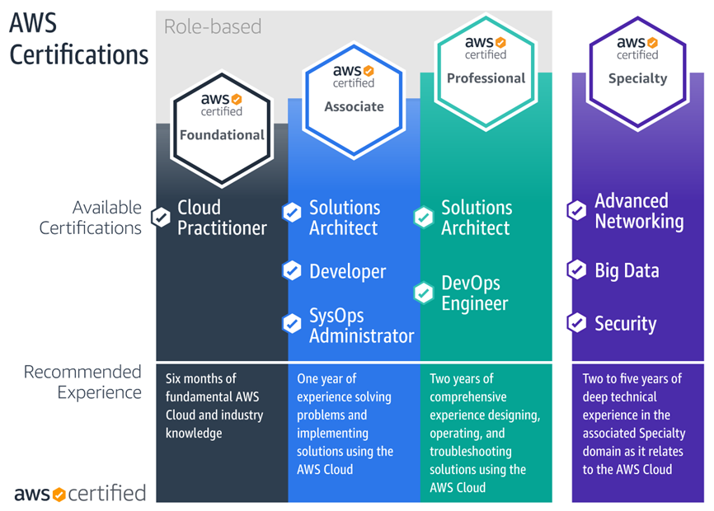
Certification Path
How to pass the AWS Associate Certification exams

